Slide 1
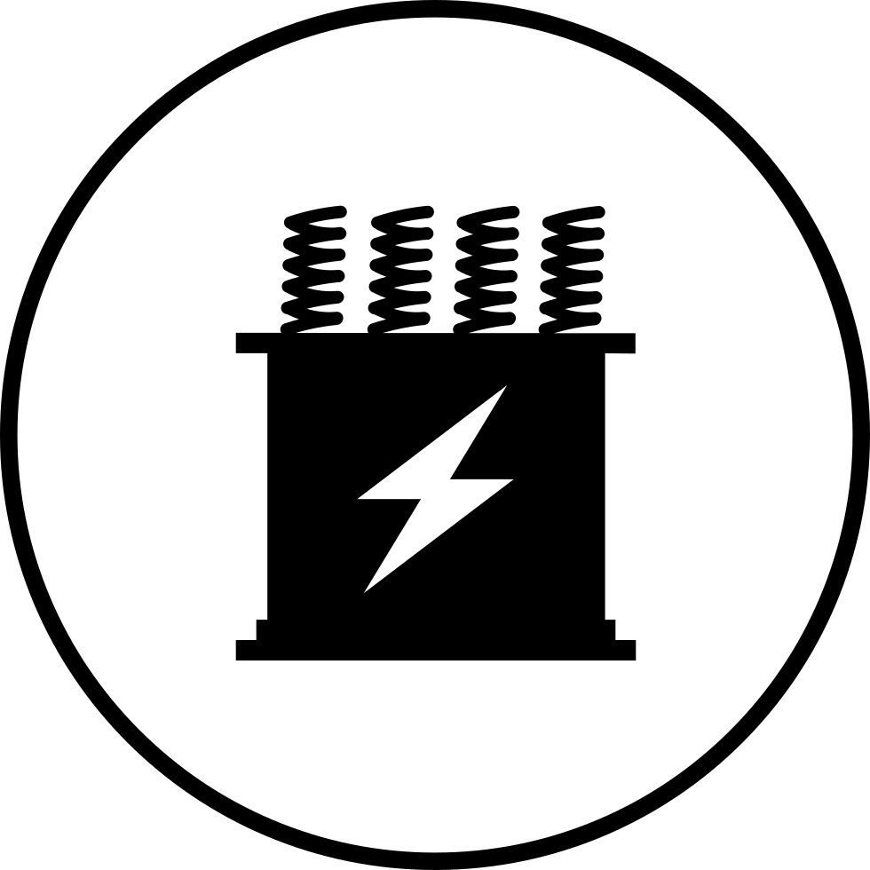
power electronics
Presentation on
Semi Controlled Rectifier
Presented By:
Amanjeet Kumar ( BT18EE011 )

Slide 2
Topics to be cover :
Introduction
Silicon Controlled rectifier (SCR)
Static V-I Characteristics of SCR
Protection of SCR

Slide 3
Introduction
The name ‘Thyristor’ is derived by a combination of the capital letters from THYRatron and transISTOR.
International Electrotechnical Commission (IEC) in 1963 decided the definition of thyristor as under :
It constitutes three or more p-n junctions.
It has two stable states, an ON-state and can change its state from one to another.
Thyristor is a four layer, three-junction, p-n-p-n semiconductor device.

Slide 4
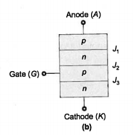

Silicon Controlled Rectifier (SCR)
SCR is the oldest at first member of thyristor family.
It is called SCR because silicon is used for its construction and its operation as a rectifier very low resistance in forward conduction and very high resistance in the reverse direction can be controlled.
It has three terminals
Anode(A)
Cathode(K)
Gate(G)
Figure : 1
Figure : 2

Slide 5
The structure of SCR
The terminal connected to outer ‘p’ region is called anode.
The terminal connected to outer ‘n’ reason is called cathode.
The terminal connected to inner ‘p’ region is called the gate.
SCR is a unidirectional device. It blocks the current flow from cathode to anode.

Slide 6
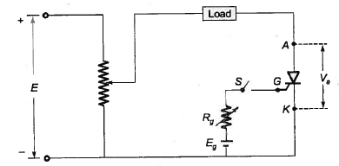
Static V-I Characteristics of SCR
An elementary circuit diagram for obtaining static V-I characteristics of SCR is shown in figure,
Fig. : 3
The anode and cathode are connected to main source through the load.

Slide 7
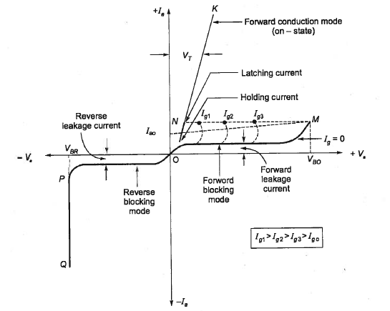
The static V-I characteristics of SCR are shown below,
V_{a} = Anode Voltage
I_{a} = Anode Current
V_{BO} = Forward Breakover Voltage
V_{BR} = Reverse Breakdown Voltage
I_{g} = Gate Current
I_{L} = Latching Current
I_{H} = Holding Current
Fig. : 4

Slide 8
1. Reverse blocking mode :
When cathode is made high potential with respect to anode with gate open, then the SCR said to be reverse biased.
J₁ and J₃ are reverse biased and J₂ is forward biased.
Small current flows through the SCR this is called as reverse leakage current.
This is reverse blocking mode called the off state of the SCR.
If the reverse voltage is increased then at reverse breakdown voltage and avalanche occurs at J₁ and J₃ and the reverse current increases rapidly.(PQ)
The SCR in the reverse blocking mode may therefore be treated as an open switch.

Slide 9
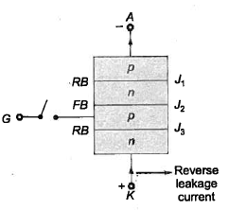
Fig. : 5 – Reverse Blocking Mode of SCR

Slide 10
2. Forward blocking mode:
When anode is at higher potential than cathode, with gate circuit open, thyristor is said to be forward biased.
It is seen from the figure that J₁, J₃ are forward bias but junction J₂ is reverse bias.
In this mode a small current called forward leakage current flows from anode to cathode.
OM in the V-I characteristics represents the forward blocking mode of SCR.
SCR is treated as an open switch in the forward blocking mode.

Slide 11
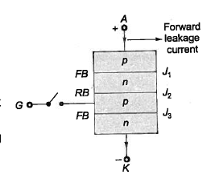
Figure 6 : Forward blocking mode of SCR

Slide 12
3. Forward conduction mode:
When anode to cathode forward voltage is increased with gate circuit open reverse biased junction J₂ will have an avalanche breakdown voltage called forward breakover voltage V_{BO}.
After this breakdown, thyristor gets turned on with point M at once shifting to N. Here NK represents the forward conduction mode.
Thyristor can be bought from forward blocking mode to forward conducting mode by turning it on by applying.
A positive gate pulse between gate and cathode (or)
A forward breakover voltage VBO across anode and cathode.
Voltage drop across the SCR, V_{T} increases slightly with an increase in anode current. it can be seen from NK.

Slide 13
Latching current(I_{L}) :
It is defined as the minimum value of anode current I_{a} which it must attend during turn on process to maintain conduction when gate signal is removed.
The gate pulse width should be chosen to ensure that the anode current I_{a} just above the latching current I_{L}
Holding current (I_{H}) :
It is defined as the minimum value of anode current below which it must fall for turning off the SCR.
Letting current I_{L} is more than holding current I_{H}.
i.e. I_{L} > I_{H}
Letting current is associated with turn on process.
Holding current is associated with turn off process

Slide 14
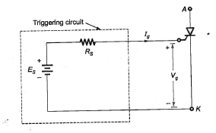
Gate characteristics of SCR
Trigger circuit connected to gate cathode circuit of an SCR.
Fig. : 7

Slide 15
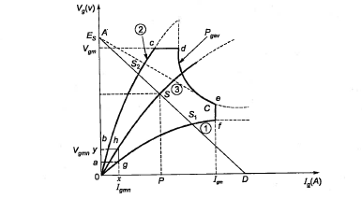
Forward Gate characteristics of SCR
Fig. : 8

Slide 16
V_{g}, I_{g} characteristics has spread between two curves 1 and 2 as shown in figure.
Curve and corresponds to get with maximum doping. So it requires lowest voltage values that must be applied to turn on the SCR.
Curve 2 corresponds to gate with minimum doping. So it requires highest possible voltage values that can be safely applied to gate circuit.
Each SCR has maximum limit as V_{gm} for gate voltage and I_{gm} for gate current. There is also average gate power dissipation P_{gav} specified for each SCR.
V_{gm} and I_{gm} are the minimum limits for GATE voltage and gate current for turn on of SCR.
The above figures show that the preferred gate drive area for an SCR is ‘bcdefghb’.
For selecting the operating point of the circuit load line is drawn from A to D. Where as,
E_{s} = Gate Source Voltage = OA
OD = Trigger Circuit Short Circuit Current =[E_{s}/R_{s}]

Slide 17
Curve 3 gives the operating point ‘S’. Thus for this SCR,
Gate voltage = PS
and
Gate Current = OP
Operating point s which may change from S₁ to S₂ and must lie within the limit curves 1 and 2 and must be as close to the curve as possible.
The minimum value of gate source series resistance r is obtained by drawing a line AC tangent to P_{gav} curve.

Slide 18
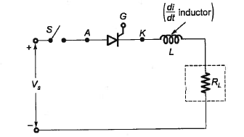
Protection of SCR
di/dt protection
When a thyristor is forward biased and is turned on by gate pulse conduction of anode current begins. If the rate of rise of anode current is very fast compared with the spreading velocity of a turn on process local hot spots will be formed. This localised heating may destroy the thyristor. Therefore the rate of rise of a note current at the time of turn on must be kept below the specified limiting value.
By using a small inductor called di/dt inductor in series with the anode circuit.
Fig. : 9

Slide 19
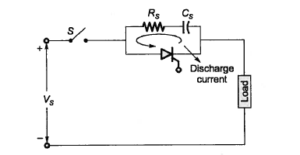
dv/dt protection
If the rate of rise of suddenly applied voltage across the resistor is hard the device get turned-on. Such phenomena of turning on a thyristor called dv/dt turn on must be avoided as it leads to false operation.
False turn on of a SCR by large dv/dt, even without application of gate signal can be prevented by using a Snubber circuit in parallel with the device.
A Snubber circuit consists of a series combination of resistance and capacitance in parallel with the thyristor as shown in figure.
Design of Snubber circuit
Fig : 10 - Snubber circuit across SCR

Slide 20
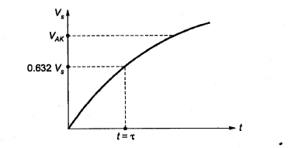
Fig : 11
When switch s is closed a sudden voltage appears across the circuit. Capacitor C_{s} behaves like a short circuit, therefore voltage across SCR is zero. With the passage of time voltage across C_{s} builds up at a slower rate such that the dv/dt across C_{s} and therefore across SCR is less than the specified maximum dv/dt rating of the device.
In order to limit their magnitude of discharge current a resistance R_{s} is inserted in series with C_{s}.

Slide 21
Over voltage protection
A SCR may be subjected to internal or external over voltages.
Internal over voltages
Due to the presence of the series inductance L_{s} of the the SCR circuit large transient voltage is produced and this internal voltage maybe e several times the break over voltage off the SCR the thyristor may be destroyed permanently.
External over voltages
Over voltages are caused due to the lightning strokes and switching surges.
For reliable operation the over voltages must be suppressed by adapting voltage clamping device (v.c).
A voltage clamping device is a nonlinear resistor connected across SCR figure. The voltage clamping device has following resistance characteristics with increasing voltage. Under normal conditions the device has a high resistance and drought only a small leakage current. When a voltage surge appears the voltage clamping device operate in low resistance region and produces is short circuit across SCR after the surge is treated IT returns to normal high resistance.

Slide 22
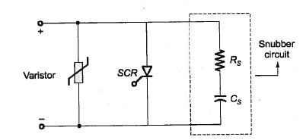
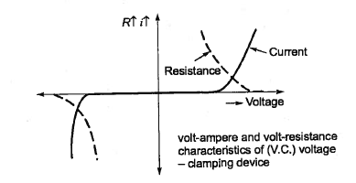
Fig : 12
Fig . 13

Slide 23
Over Current Protection
If a SCR is subjected to overcurrent due to faults, short circuit (or) surge current, its junction temperature may exceed the rated value and the device may be damaged.
There is a need for the overcurrent protection of SCR.
Fast acting current limiting fuse(FACLF)
Circuit breakers are used.
Gate Protection
Over voltages and over currents across the grid circuit can cause false triggering of the SCR.
Protection against over voltages is achieved by connecting a zener diode ZD across the gate circuit.
Protection against the overcurrent is achieved by connecting a transistor R2 in series with gate circuit.
A capacitor and a resister and also connected across Kittu cathode to bypass the noise signals.

Slide 24
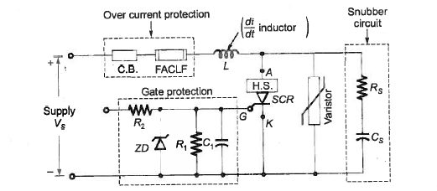
Circuit Components Showing The Thyristor Protection
Fig : 13
Thermal protection
If temperature increases installation is weakened, resulting in leakage currents which interference with operation. Heat sinks which include aluminium disk are used along with ventilating ducts, increased surface area coolants are used.

Slide 25


